Slide 1


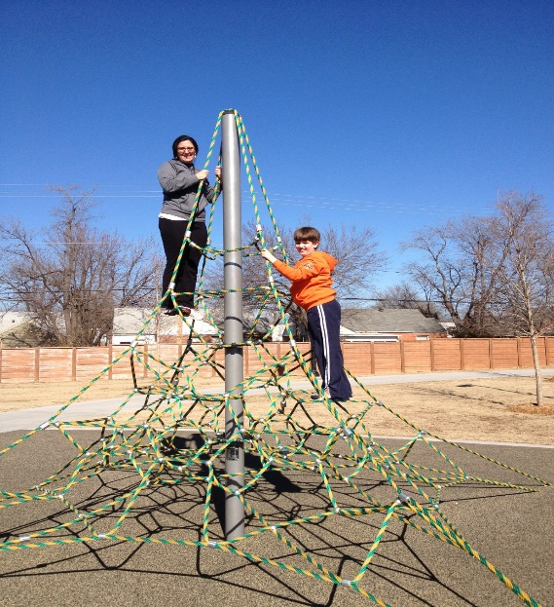
Advancing Medical Education:
The Obesity Medicine Education Collaborative
Core Competencies in Obesity Medicine
Colony S. Fugate, D.O., FACOP
Diplomate, American Board of Obesity Medicine
George Kaiser Family Foundation Endowed Chair of Pediatrics
Clinical Professor of Pediatrics
Director, Family Health and Nutrition Clinic
Oklahoma State University Center for Health Sciences
colony.fugate@okstate.edu

Slide 2
Relevant Disclosures and Resolutions
George Kaiser Family Foundation Endowed Chair of Pediatrics

Slide 3
Objectives
After attending this presentation, participants will be able to:
  Discuss the rates of obesity and related costs
  Review the history of medical education as related to nutrition and obesity
  State the mission of the Obesity Medicine Education Collaborative
  Locate resources to support medical education in obesity medicine
  Implement obesity medicine core competencies within their training program

Slide 4
Obesity Rates
36.5% of Oklahoma adults have obesity.
18.7% of Oklahoma children ages 10 to 17 have obesity.
13.8% of children ages 2 to 4 who receive WIC benefits are obese (2014).
12.7% of Oklahomans have diabetes.
37.7% of Oklahomans have hypertension.
32.4% of Oklahoma’s adults report zero physical activity within the 30-day reporting period. Oklahoma is the 4th most physically inactive state.
34.5% of Oklahoma adults drink sugar-sweetened beverages more than once daily.
Only 8% and 6% of Oklahomans meet recommended daily intake of fruits and vegetables respectively
Robert Wood Johnson Foundation, Trust for America’s Health, Gavathri, et al 2012, Lee-Kwan, et al 2017

Slide 5
Obesity Related Complications
Cardiometabolic Diseases | Biomechanical Diseases | Other
Dyslipidemia Pre-DM DM HTN CVD Stroke NAFLD/NASH Metabolic Syndrome | Stress incontinence Sleep apnea Hypoventilation syndrome Hernias Osteoarthritis Chronic pain DVT/blood clots Venous stasis | GERD Nephrolithiasis Cholelithiasis Skin disorders Infertility Depression Cancer Gout Dysomnia Disordered eating Surgical treatments and complications

Slide 6
The Cost of Obesity
U.S. estimated annual direct medical costs of obesity is estimated to be between $147 billion (in 2008) to $480.7 billion (2016) depending on measures used.
Annual spending attributable directly to treating obesity and obesity related diseases in Oklahoma is estimated to be $854 million (1998-2000).
Indirect costs attributable to obesity are estimated at $1.24 trillion per year (2016).
Obesity is associated with 1.1 to 1.7 extra days missed work annually at a cost of $8.65 billion per year nationally.
Estimated costs attributed to obesity related absenteeism are $243 per employee annually in Oklahoma for a total estimated cost of obesity related absenteeism of $119.5 million per year in Oklahoma
Finkelstein, et al 2009; Cawley and Meyerhoefer 2012; Waters and Graf 2018; Finkelstein, et al 2004; Andreyeva, et al 2012

Slide 7
Barriers to Care
  Health care access
  Poverty
  Individual motivation
  Time
  Reimbursement
  Physician knowledge
Findholt, et al 2013

Slide 8
Medical Education
  Surgeon General’s Report on Nutrition and Health
  Nutrition Academic Award
  American Association of Medical Colleges
  Bipartisan Policy Center
  Obesity Medicine Education Collaborative

Slide 9

Obesity Medicine Education Collaborative
Mission:
To develop obesity-focused competencies
and evaluation benchmarks that can be directly incorporated into training by education committees and program directors
OMEC

Slide 10
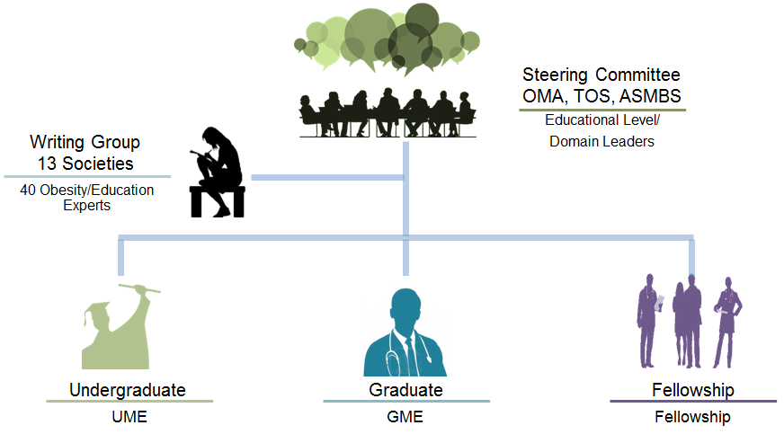
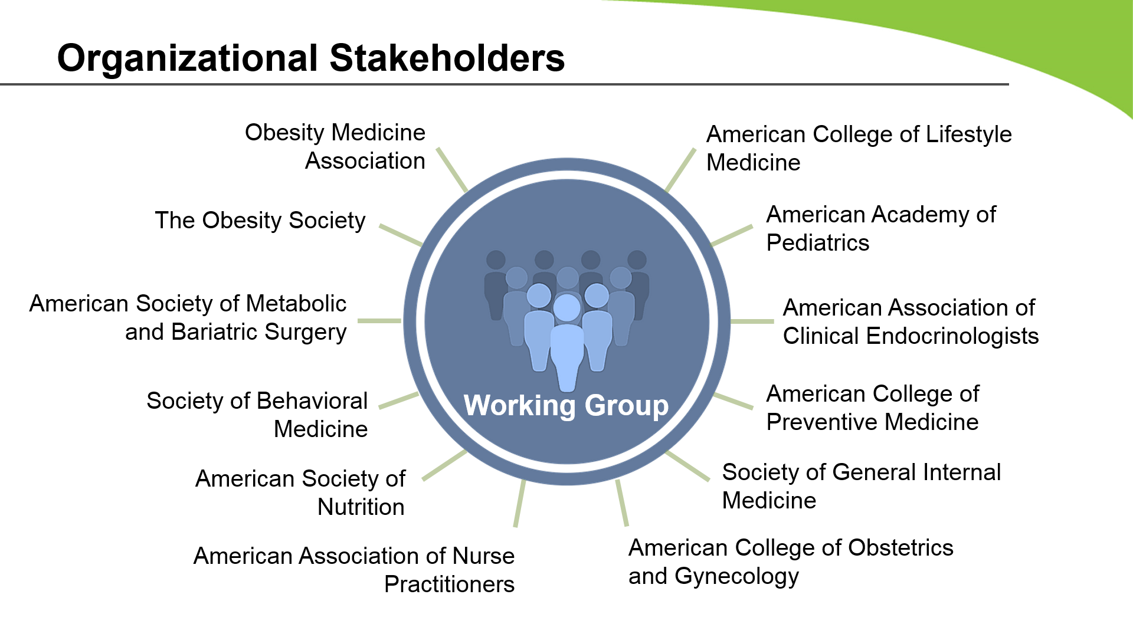



Obesity Medicine Education Collaborative
Steering Committee: OMA, TOS, and ASMBS
Robert Kushner, Deborah Horn, Scott Butsch, John Morton, Nick Pennings, Ethan Lazarus, Caroline Apovian
OMEC

Slide 11
Obesity Medicine Education Collaborative Project Outline
A. Identify Domains and Competencies
B. Identify Benchmarks
C. Identify Entrustable Professional Activities
D. Examples of Curriculum Content and Design
  Phase I
  A/B Completed
  Phase II Completed
External Review
  Phase III In Progress
Endorsement & Dissemination
OMEC

Slide 12
External Review Stakeholders
American Academy of Physician Assistants
Academy of Nutrition and Dietetics
American Association of Clinical Endocrinologists
American College of Physicians
American Academy of Family Physicians
American Gastroenterological Association
American College of Preventive Medicine
American Society of Addiction Medicine
American Academy of Sleep Medicine
American Heart Association
Endocrine Society
American College of Obstetrics
and Gynecology
American Academy of Pediatrics Section on Obesity
American Association of Medical Colleges
American Medical Association
Society of General Internal Medicine
American Medical Women’s Association
dddd
Thank You!
OMEC

Slide 13

















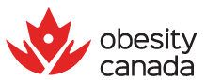
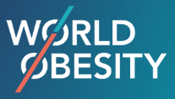
Endorsing Organizations
Obesity Action Coalition
Society of Teachers of Family Medicine
Society of Behavioural Medicine
American Medical Women’s Assoc.
American Board of Obesity Medicine
Academy of Nutrition and Dietetics
American Society of Metabolic
and Bariatric Surgery
The Obesity Society
Obesity Medicine Association
Obesity Canada
Endocrine Society
American College of Surgeons
American Society for Gastrointestinal Endoscopy
Association for Bariatric Endoscopy
American Association of Clinical Endocrinologists
American Association of Nurse Practitioners
Society of General Internal Medicine
American College of Osteopathic Pediatricians
American Academy of Physician Assistants
World Obesity Federation
OMEC

Slide 14
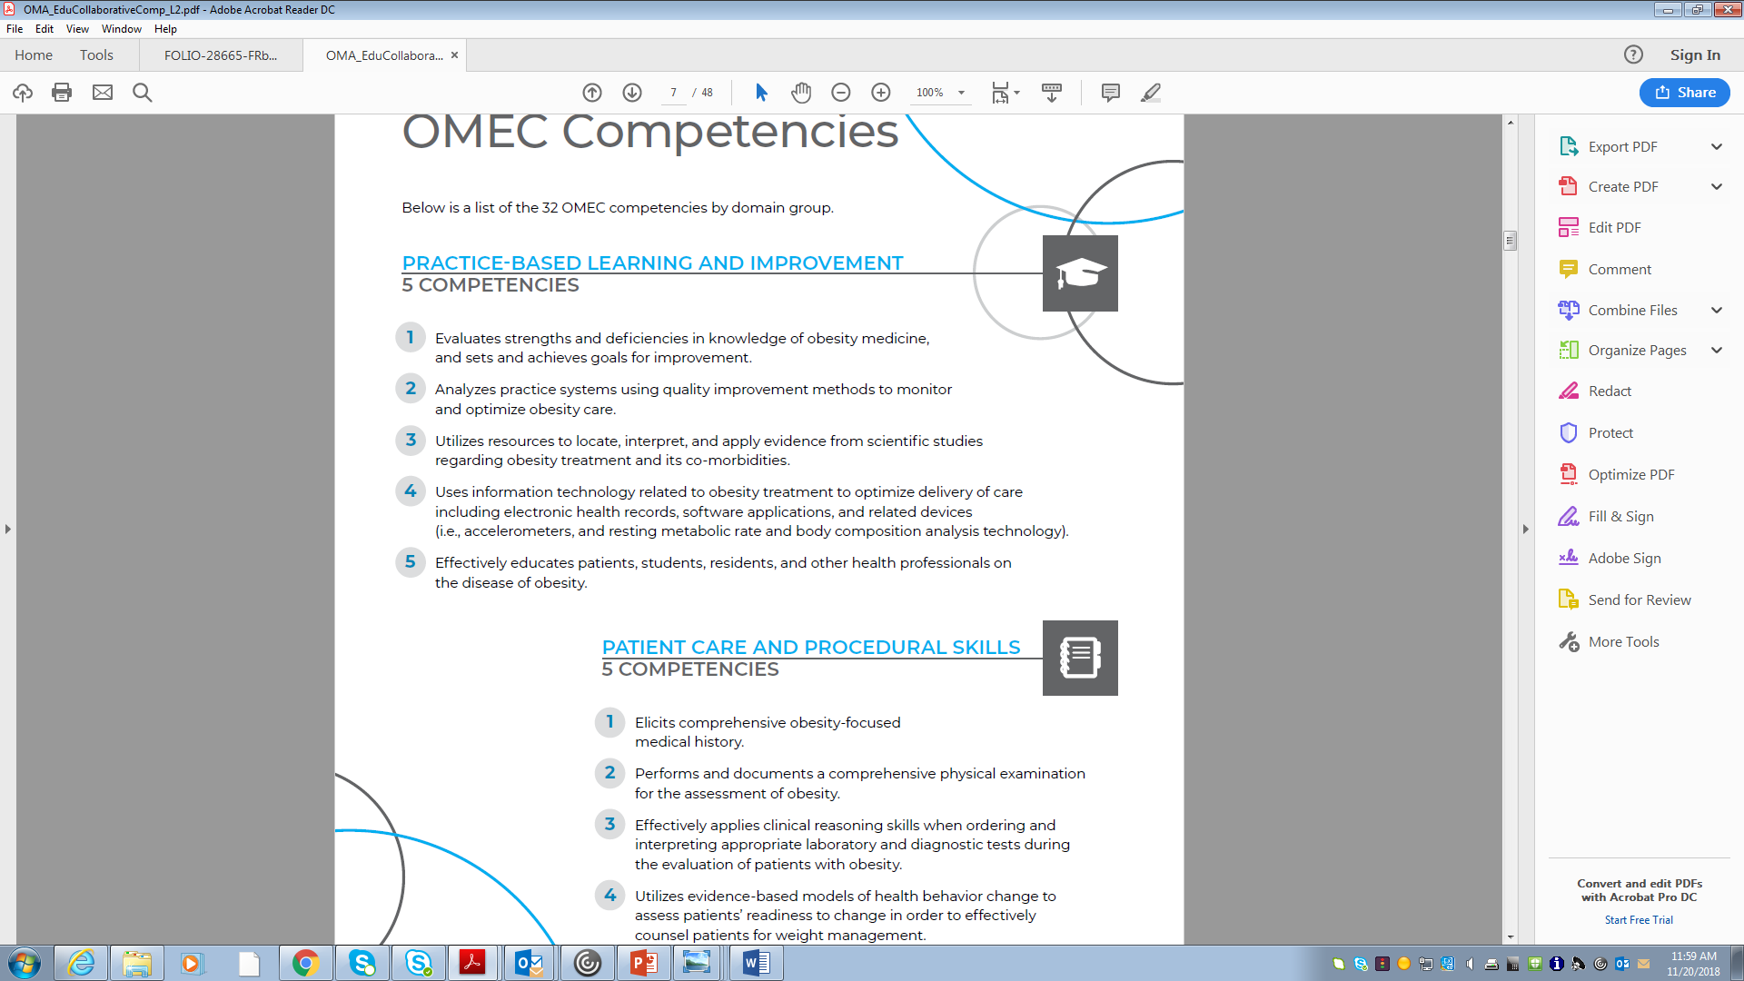

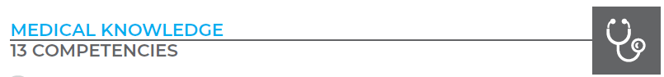
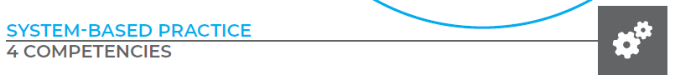

6 Domains & 32 Competencies
Accreditation Council for Graduate Medical Education (ACGME)
consistent approach to allow for familiarity & adoption
OMEC

Slide 15
Competency Applications
  Traditional Educational Pathways
  Beyond Traditional Classrooms & Rotations
Novel Provider Training
  Curriculum Guidance
  Periodic Evaluation
  Standardized Testing
    Primary and Specialty Board Question Banks
  Primary Targets:
  Undergraduate: Medical School
  Graduate: Residency
  Fellowship
    Obesity Med Fellowship Council (OMFC)
  Advanced Practitioners
Practice Systems + Business Applications
Practicing HCP Training/CME/MOC
Employer/System driven education
Quality Improvement
OMEC

Slide 16
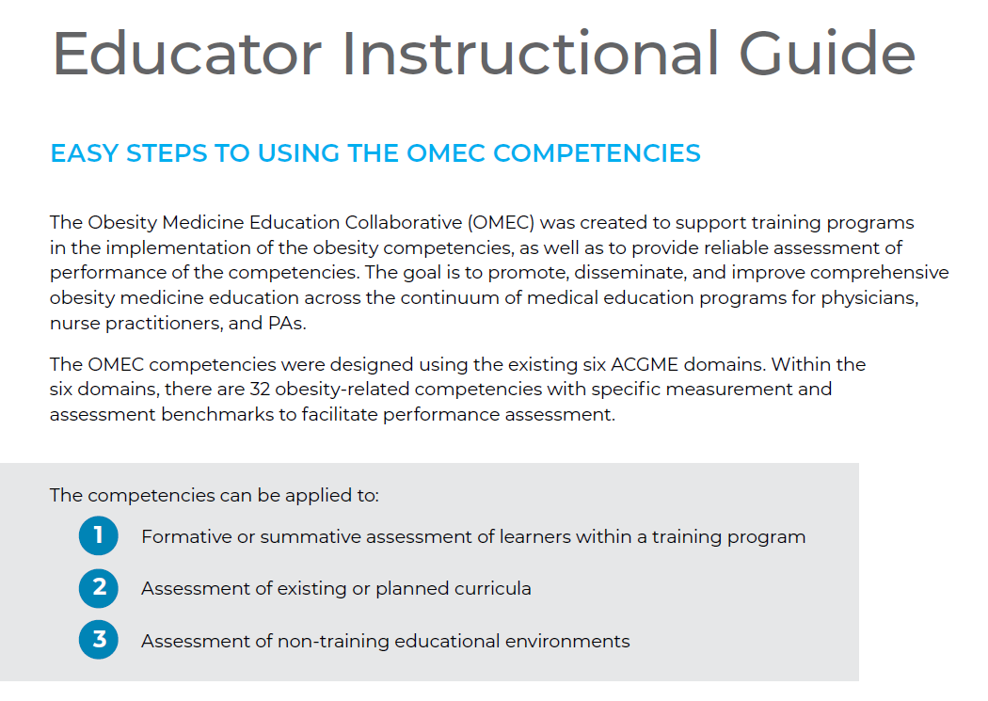
The OMEC Tool Box
OMEC

Slide 17
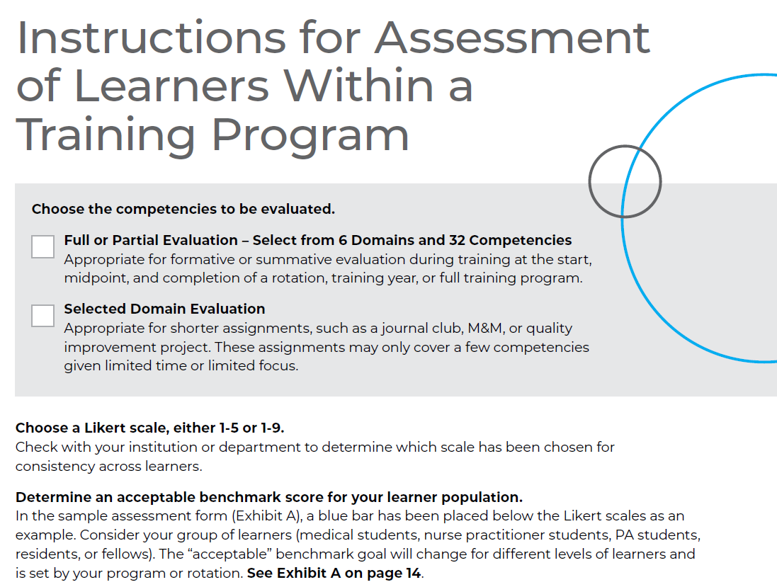
The OMEC Tool Box
OMEC

Slide 18
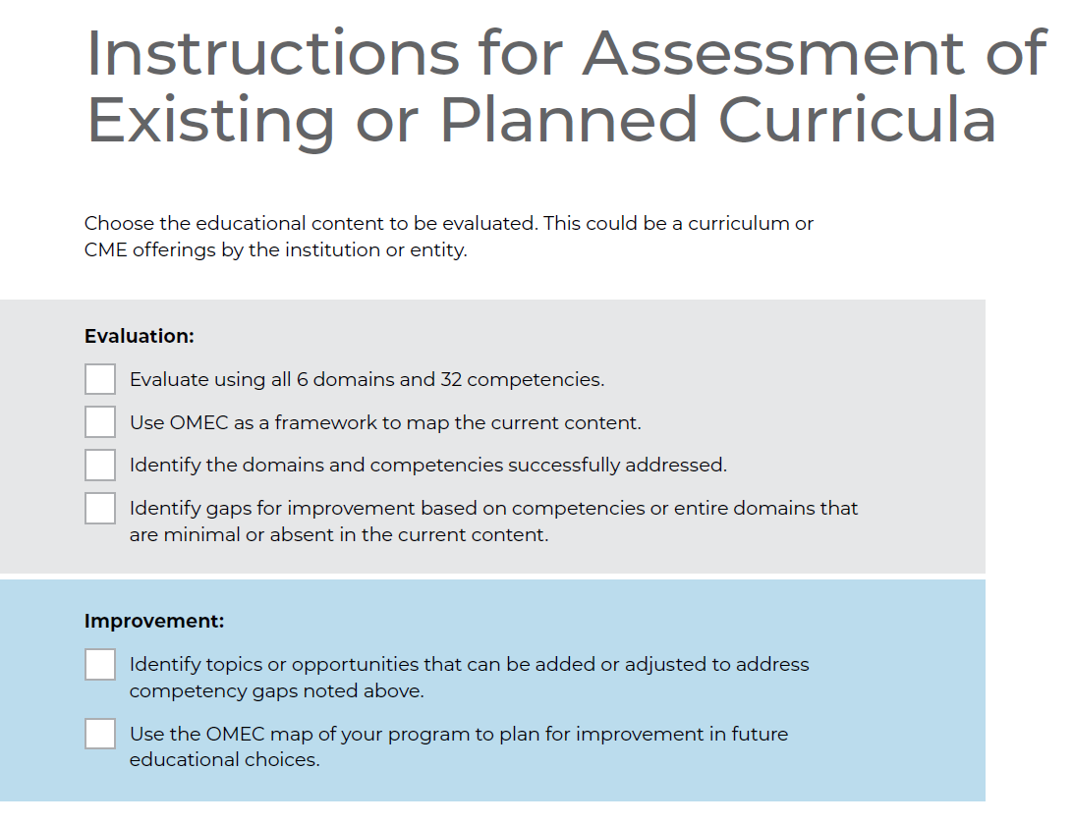
The OMEC Tool Box
OMEC

Slide 19
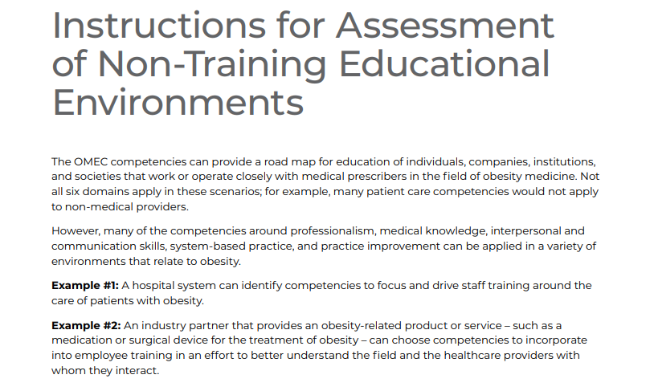
The OMEC Tool Box
OMEC

Slide 20
In Medical Education…What is Competency?
Competency
An observable ability of a health professional related to a specific activity that integrates knowledge, skills, values, and attitudes.
Frank, JR et al 2010

Slide 21
Competencies and Benchmarks
Benchmarks allow for evaluation of the learner
at any level, for a given competency
Early Competency Excellence
  Example:
    Domain: Interpersonal and Communication Skills
    Competency: Uses appropriate language in verbal, nonverbal, and written communication that is non- biased, non-judgmental, respectful, and empathetic when communicating with patients with obesity
  Competency Example
  Consider a early learner and identify a score
OMEC

Slide 22
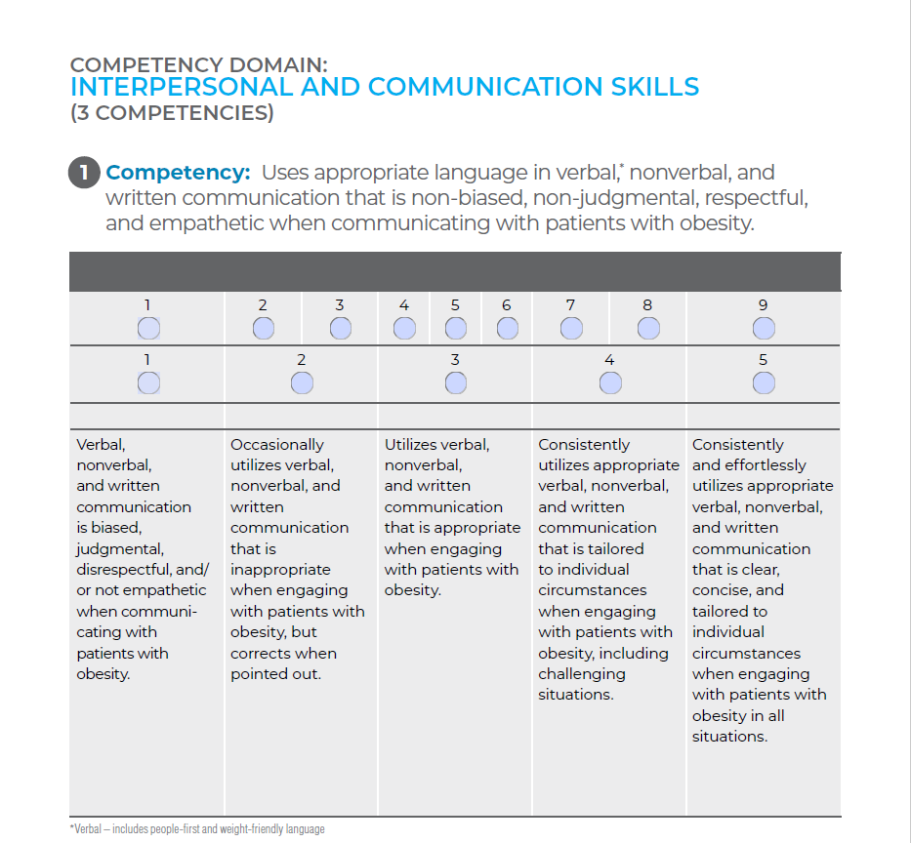
Competencies and Benchmarks
OMEC

Slide 23
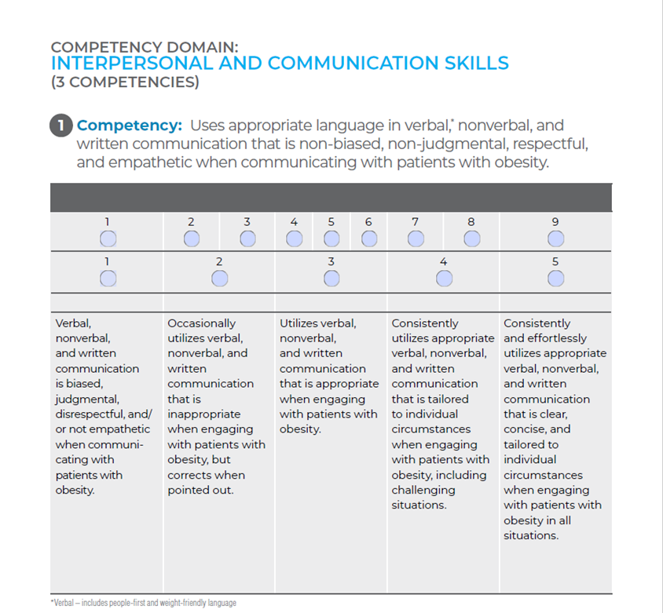
Competencies and Benchmarks
OMEC

Slide 24
Competencies and Benchmarks
Expectation of benchmark improvements as training advances.
  Example:
  Domain: Medical Knowledge
  Competency: Apply knowledge of the pharmacological treatments of obesity as a part of a comprehensive personalized obesity management plan
  Competency Example
  Consider an advanced learner and identify a score
OMEC

Slide 25
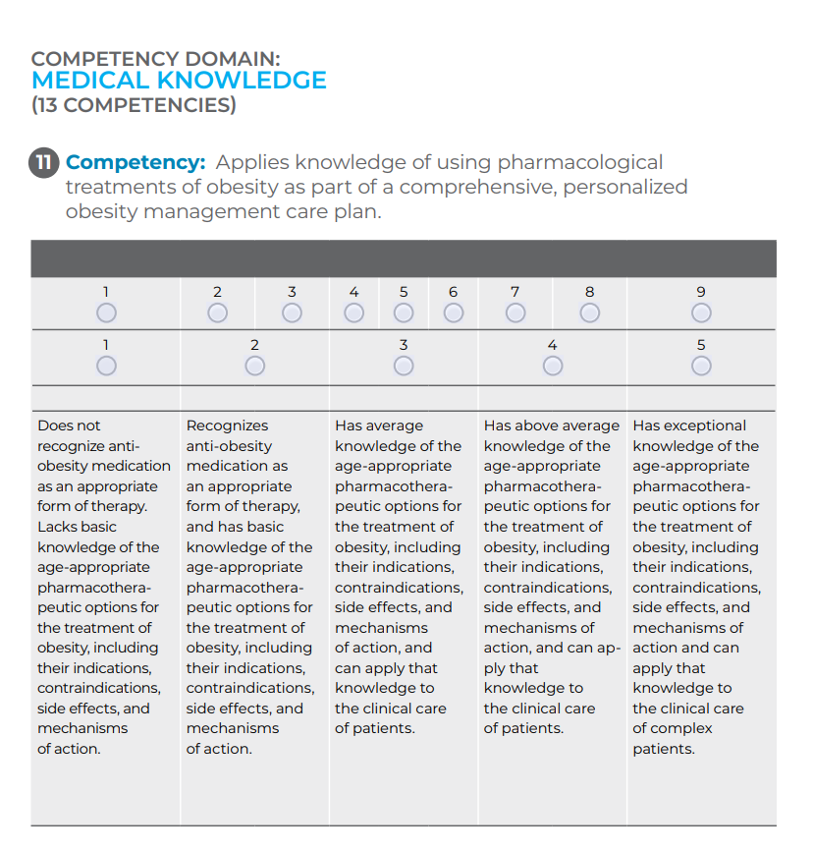
Competencies and Benchmarks
OMEC

Slide 26
Competencies and Benchmarks
Expectation of benchmark improvements based on knowledge & practice
  Example:
  Domain: Patient Care and Procedural Skills
  Competency: Utilizes evidence-based models of health behavior change to assess patients’ readiness to change in order to effectively counsel patients for weight management.
  Competency Example
  Consider a recent learner and identify a score
OMEC

Slide 27
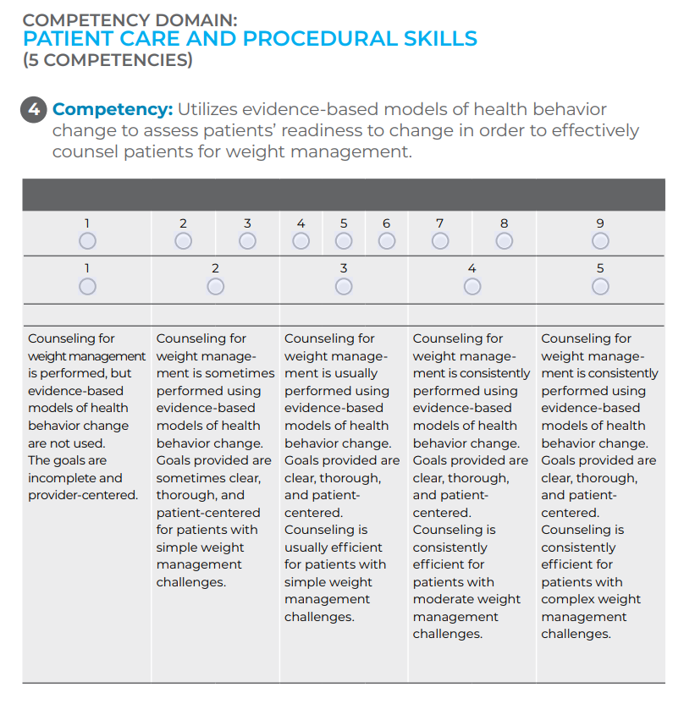
Competencies and Benchmarks

Slide 28
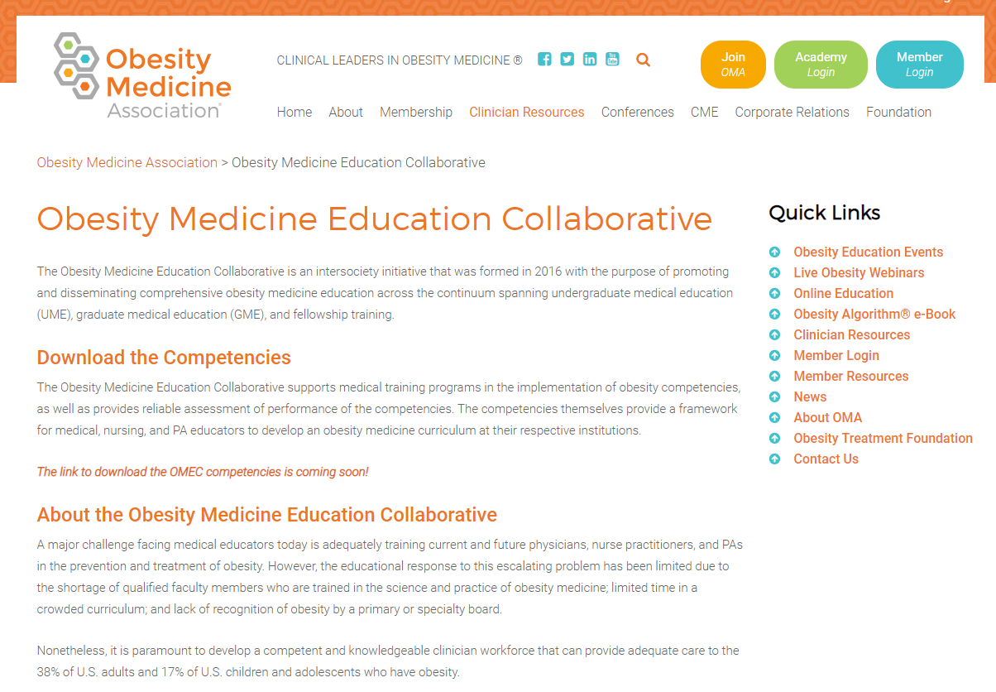
Obesity Medicine Core Competencies
www.obesitymedicine.org/omec/
OMEC

Slide 29
We are here to help!
Pediatric Obesity Medicine ECHO https://health.okstate.edu/echo/obesity-echo.html
Obesity Medicine Focus Course
Pediatric Obesity Medicine Clerkship
Continuing medical education
Professional consultation services
Curricula, entrustable professional activities, assistance with core competency implementation
OSUCHS ECHO, OSUCHS Family Health and Nutrition Clinic

Slide 30
Acknowledgements
Robert Kushner, MD, MS, FACP, FTOS
Deborah Bade Horn, DO, MPH, MFOMA
W. Scott Butsch, MD, MSc, FTOS
Nicholas Pennings, DO, FOMA
…..and the rest of the 32 members of the Obesity Medicine Education Collaborative working group!
OMEC

Slide 31
References
  State of Obesity, Better Policies for a Healthier America, Robert Wood Johnson Foundation accessed 2/2/2019 https://stateofobesity.org/states/ok/
  Trust for America’s Health https://www.tfah.org/state-details/oklahoma/
  Gayathri KS, et al. Sugar-Sweetened Beverage Consumption Among Adults- 18 States, 2012. MMWR Morb Moral Wkly Rep 2014; 63(32); 686-690. https://www.cdc.gov/mmwr/preview/mmwrhtml/mm6332a2.htm
  Lee-Kwan SH, Moore LV, Blanck HM, Harris DM, Galuska D. Disparities in State-Specific Adult Fruit and Vegetable Consumption — United States, 2015. MMWR Morb Mortal Wkly Rep 2017;66:1241–1247. DOI: http://dx.doi.org/10.15585/mmwr.mm6645a1
  Finkelstein et al. Annual Medical Spending Attributable To Obesity: Payer and Service-Specific Estimates. Health Affairs; 2009; 28, 5; Proquest pg W822.
  Cawley J and Meyerhoefer C. “The Medical Care Costs of Obesity: An Instrumental Variables Approach.” J Health Econ. 2012 Jan; 31 (1): 219-30. doi: 10.1016/j.healeco.2011.10.003.Epub 2011 Oct 20.
  Waters H and Graf M “American’s Obesity Crisis, The Health and Economic Costs of Excess Weight” Milken Institute. 2018 Oct. https://assets1c.milkeninstitute.org/assets/Publication/ResearchReport/PDF/Mi-Americas-Obesity-Crisis-WEB.pdf
  Finkelstein et al. State-level estimates of annual medical expenditures attributable to obesity. Obesity Research 2004; 12(1):18–24.
  Andreyeva, T, Luedicke, J, Wang, C. “State-Level Estimates of Obesity Attributable Costs of Absenteeism.” J Occup Environ Med. 2014 Nov; 56(11): 1120-1127. Doi:10.1097/JOM.0000000000000298
  Findholt, NE, Davis, MM, Michael, YL. “Perceived Barriers, Resources, and Training Needs of Rural Primary Care Providers Relevant to the Management of Childhood Obesity.” J Rural Health 2013; 29: s17-s24.
  Koop, CE. The Surgeon General’s Report on Nutrition and Health 1988 United States Department of Health and Human Services Public Health Service DHHS (PHS) Publication No. 88-50210
  Pearson, TA, et al. Translation of nutritional sciences into medical education: the Nutrition Academic Award Program. Am J Clin Nutr 2001; 74: 164-70.
  Van Horn, L. The Nutrition Academic Award: brief history, overview, and legacy. Am J Clin Nutr 2006; 83 (suppl): 936S-40S.
  American Association of Medical Colleges. Contemporary Issues in Medicine: The Prevention and Treatment of Overweight and Obesity Medical School Objectives Project. August 2007.
  Bradley, D.W., Dietz, W.H., and the Provider Training and Education Workgroup. Provider Competencies for the Prevention and Management of Obesity. Washington, D.C. Bipartisan Policy Center, June 2017. Available at: https://bipartisanpolicy.org/library/providercompetencies-for-the-prevention-and-management-of-obesity.
  Kushner, R, Horn, DB, Butsch, WS and Workgroup. Obesity Medicine Education Collaborative Obesity Competencies. 2019. www.obesitymedicine.org/OMEC
  Frank, JR., et al 2010 Competency based medical education theory to practice. Medical Teacher 32(8):638-645. American Association of Colleges of Medicine
  Special recognition for assistance with presentation: Debra Horn, DO, Robert Kushner, MD, and the Obesity Medicine Education Collaborative steering committee

